Slide 1
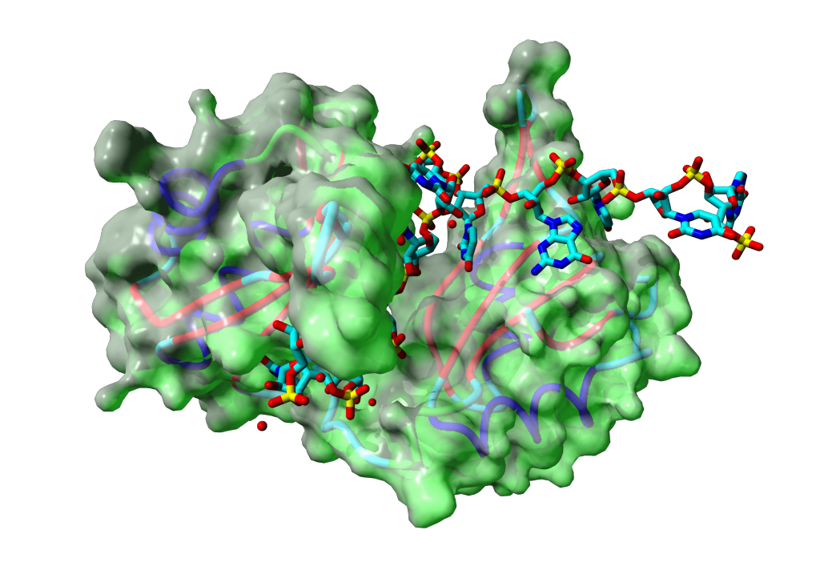

Title title title title title title title title title title title title title title
RNAct Final conference:
Tailoring RNA binding proteins and RNA targeting
14th – 15th September 2022
Speaker
Affiliation

Slide 2

Index
Part 1
Sub part 1
Sub part 2
Part 2
Sub part 1
Sub part 2
Part 3
Sub part 1
Sub part 2
…
…

Slide 3
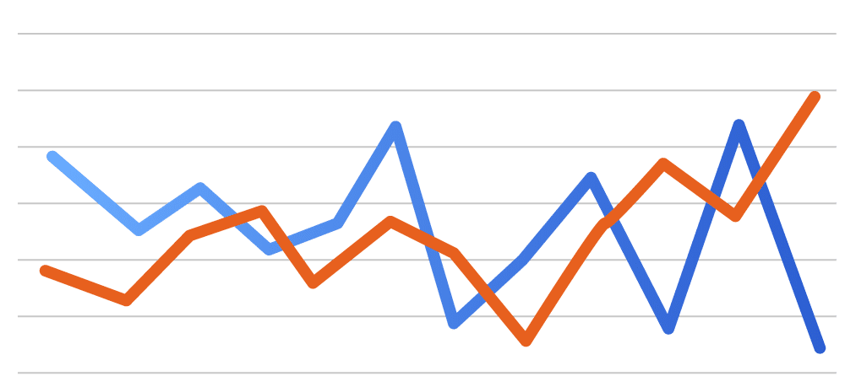
Title of the slide
Statements/observations/questions
A description for the graph/Sample condition

